Slide 1
Building R-packages – Git and GitHub
Raphael Hartmann
raphael.hartmann@staff.uni-marburg.de

Slide 2
Learning objective
What are advantages of Git and GitHub?
How does GitHub improve your collaboration?

Slide 3


Git and GitHub
Git: Version control system:
Track changes
Work with others (on the same files)
GitHub: Website for hosting your code
Share your projects/code with others
R-packages on it can be installed with devtools::install_github()
Make easy website for your package (and other things) using Markdown
Others can suggest changes to your code

Slide 4
Integration in RStudio
You can use Git in an RStudio project
Use the most basic features of Git by clicking buttons
This works in 90% of the cases just fine
Nevertheless: You need to learn
The basics of Git and
The basics of using a Terminal/Shell/command-line

Slide 5
Terminal basics repetition
We already looked at some terminal commands:
list the content of your current directory you are in:
ls
list the content of another directory:
ls /path/to/another/directory
change the current directory:
cd /path/to/new/directory
change the current directory in relation to your current directory:
cd ./path/to/subdirectory

Slide 6
Setup
Install Git and create a GitHub account:
Download and install Git: https://git-scm.com/download/
In RStudio Terminal or GitBash write:
git config --global user.name "YOUR FULL NAME"
git config --global user.email "YOUR EMAIL ADDRESS“
git config --global --list
Create an account on GitHub with same emailaddress: https://github.com
Download and install an SVN client: https://subversion.apache.org/packages.html#windows (I use SlikSVN)

Slide 7
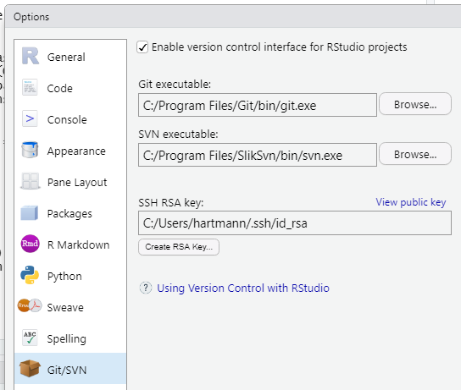
Setup
Install Git and create a GitHub account:
Restart RStudio
Make an SSH key: Go to „Tools > Global Options… > Git/SVN“ and click „Create RSA Key“ → Enter a password you can remember
Copy the public key by copying the content of „View public key“
Go to https://github.com/settings/ssh and give it your SSH publik key
Click „New SSH key“, give it a name, and paste the publik key and create.

Slide 8
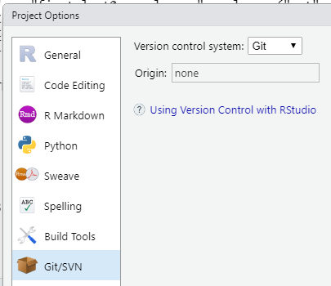
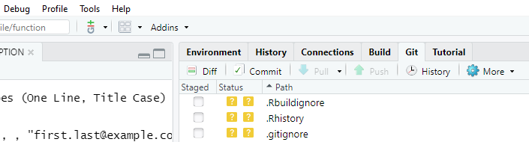
Local Git repository
Creating a new local repository:
Go to „Tools > Project Options… > Git/SVN“ and change „Version control system“ from „(None)“ to „Git“
Change to the RStudio Terminal and write git init
You can see two new components:
Git pane:
shows the most important Git commands for your project
Git-dropdown:
Includes Git & GitHub commands for the current file
Notes:
Git-Dropdown (left): includes Git and GitHub commands for the current file
Git pane (right next to environment): shows the most important Git commands for your project

Slide 9
Local Git repository
First step:
usethis::use_git()
This will:
Create the file .gitignore
Add the most important entries to .gitignore
Initialize Git

Slide 10

Short exercise
5
Install Git, an SVN client and create a GitHub account, if you do not already have one; see 3 slides back)
Create an SSH key in RStudio (if you do not have one already) and tell it GitHub (see 2 slides back)
Create a local Git repository (see 1 slide back) for your R-package
Notes:
Warning! Should appear

Slide 11
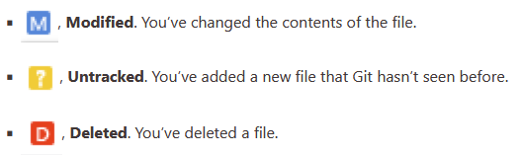
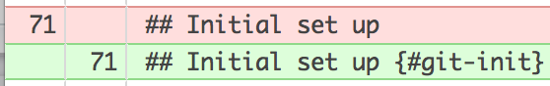
Track changes
Use the Git pane for an overview about the changes in your project:
Use the Diff function for specific changes in one of your files:
Colors indicate changes: gree = added code; red = removed code
Notes:
Color-blind people can use the columns on the left side: left = removed code; right = added code

Slide 12
Track changes – Terminal
Terminal command for an overview of your project changes:
git status
Terminal command for specific changes in one of your files
git diff /path/to/file

Slide 13
Record changes
Use the Commit function to save a snapshot of your project:
Components of a commit:
Unique identifier (SHA; secure hash algorithm)
List of changes: added, modified, deleted
Commit message
Parent commit (the one before that)
Author

Slide 14
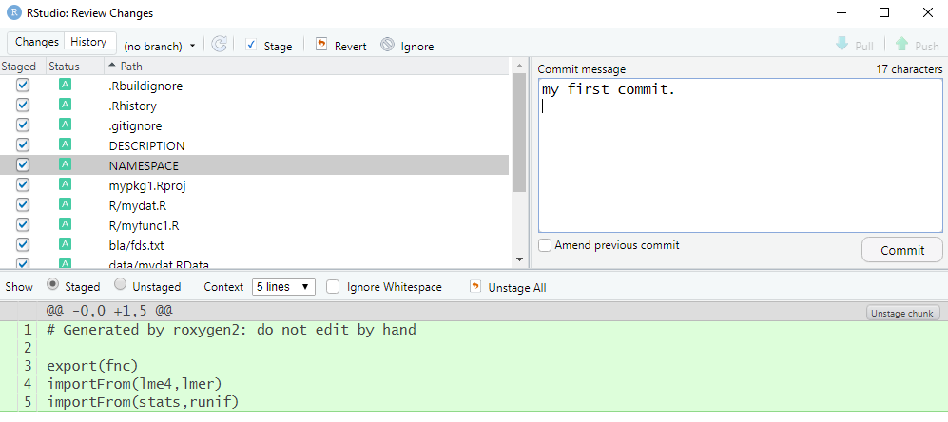
Record changes
Steps:
State which changes should be in the next commit → stage files
Make the commit with message → commit the staged files

Slide 15
Record changes – Terminal
Stage a file:
git add filename
Commit changes:
git commit –m "my commit message"

Slide 16
Commit – best practice
An optimal commit should be
minimal: only include changes related to a single problem.
complete: the problem should be solved with the commit. Add a unit test to confirm
An optimal commit message should be
concise and evocative: it should be clear at a glance, what the commit was about, but also detailed enough to remember what you did
explanatory: it should provide reasons for the changes
Notes:
At least the future-you will profit from your effort
concise=prägnant
evocative=herausschreiend

Slide 17
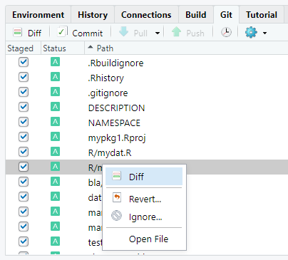
Ignoring files: .gitignore
Files that should never be in a commit should be named in the file .gitignore.
In the git pane you can right-click a file and then click Ignore…
This will add the name to .gitignore
Use wildcards like *.png to let Git know that all files with this extension should be ignored

Slide 18

Workflow
Repeat the following each time you have made (major) changes:
Save your changes
(Check whether .gitignore is complete)
Open the commit window (Ctrl/Cmd+Alt+M)
Select the files that should be staged (or press Ctrl/Cmd+A to select all)
Clickthe Stage button
Write a commit message
Click „Commit“

Slide 19
Go back to your last commit
Two options for undoing changes:
Undo all changes in a file: in the Git pane right-click a file an select Revert…
Undo selected changes in the code: In the Diff-Window mark the line(s) in the code and select Discard line / Discard chunk
Notes:
There are ways to go way back to a past commit, but we will not go into that

Slide 20
Short exercise
5
Make sure .gitignore is set properly
Make some minor changes to your package and make new commit(s)
Play around with the diff-check function and the possibility to go back to your last commit
Use the Terminal to make commits
Notes:
Warning! Should appear

Slide 21
Connect your Project with GitHub (only once)
Connect your local project with a GitHub repository:
Create the repository in https://github.com/new by using the same name as your R-package and add the package title as the description of the repository. Hint: you will see a https and ssh link → copy the ssh link for the next step
Open the RStudio Terminal and type the following but use your ssh link:
git remote add origin git@github.com:<GitHub_user.name>/<pkgname>.git
git push –u origin master
If you forgot to copy your link, just fill in your GitHub user name and package name by replacing the content within <> and removing the symbols < and >

Slide 22

Updating your GitHub Repo (after each change)
Updating your GitHub Repository:
Modify your files
Example: Add the fields URL and BugReports to DESCRIPTION
URL: https://github.com/<GitHub_user.name>/<pkgname>
BugReports: https://github.com//<GitHub_user.name>/<pkgname>/issues
Save the changes and commit
Push your changes by clicking the Push button
Go to your GitHub Repository and check the changes
Note: Usually you run R CMD check before pushing and you push less often than commit

Slide 23
Short exercise
5
Make a GitHub repository and sync it with your local Git repository
Make a small change somewhere, commit and push it again and check the changes on GitHub
Notes:
Warning! Should appear

Slide 24
Push and Pull
Push: By pushing you update your GitHub repository.
This serves as a back-up and to share with others.
Pull: By pulling you update your local Git repository.
This is needed when you work with others who made changes to your package.

Slide 25
Pull
A pull does three things:
Downloades (fetches) the files from GitHub
Merges your local version with the one from GitHub
This can go wrong (see next slide)
Commits the changes

Slide 26
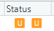
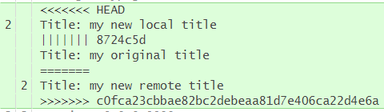
Merging problems
When your local changes and the ones that come from GitHub collide you will either get:
Merging error → Pull request fails → read error and debug
Merging conflict: Unresolved merging status → Git pane shows → local and remote commits have changes on the same line(s)
After local changes
Before changes
After remote changes

Slide 27
Merging problems
Options for merging conflicts:
Show only local and remote version (default):
git config --global merge.conflictstyle diff2
Show local, original, and remote version (see previous slide):
git config --global merge.conflictstyle diff3
Notes:
….
I will stop here with Git and GitHub since I am not an expert in working with others via GitHub. But these are the basics.

